Slide 1
Faculty Ambassador Program
AI-Based Chatbot for
Oral Health Education
Presented by
Mrs.P.V.Kavitha, AP(Sl.G)/AI&DS
LEARNER
PATIENT
RAG + AI

Slide 2
Problem Statement
01
Oral health information is often difficult to understand, access, and personalize.
• People may not know correct brushing, gum-care and cavity-prevention practices.
• Online health information can be confusing, inconsistent, or difficult to verify.
• Dental learners need a study-focused resource, while patients need simple practical guidance.
• Language, accessibility, and limited access to professional advice can create barriers.
The gap
Most generic chatbots do not clearly separate learning needs from patient-facing guidance.
Need: accessible, role-aware, source-grounded oral health support.

Slide 3
Proposed Solution
02
Build one AI web platform with two tailored chatbot experiences.
Learner Portal
Patient Portal
Detailed dental concepts, terminology, study summaries, source references, quizzes, and learning progress.
Simple Tamil/English explanations, oral-care tips, voice interaction, reminders, and clinic-finding assistance.
Shared engine: AI model + Retrieval-Augmented Generation (RAG) + trusted dental content + safety rules.
The chatbot educates and guides; it does not diagnose or replace a dentist.

Slide 4
Project Objectives
03
01 Improve awareness
02 Personalize responses
03 Ground answers
Make everyday oral-care knowledge easier to access.
Adapt language and depth for learners and patients.
Retrieve information from reviewed dental sources and show references.
04 Support learning
05 Improve access
06 Promote safe action
Offer quizzes, summaries, glossary, and progress tracking.
Add Tamil/English, voice, accessibility, and mobile-friendly design.
Flag concerning symptoms and encourage professional dental care.

Slide 5
Target Users
04
Learners
Patients & General Public
• Dental and oral-health students
• Dental hygiene learners
• Educators and trainers
Needs: detailed explanations, reliable sources, quizzes, and revision tools.
• People seeking oral-care education
• Caregivers and families
• Users who prefer Tamil or simple English
Needs: clear everyday advice, prevention tips, reminders, and help finding dental care.
Admin users manage approved content, feedback, usage insights, and safety monitoring.

Slide 6
Key Features
05
Role-based login
AI chatbot + RAG
Tamil + English voice chatbot
Separate learner and patient experiences.
Retrieve content from trusted dental sources.
Voice input and spoken answers in Tamil or English.
Personalized oral care planner
Dental concern safety checker
Dental clinic finder
Daily routines, reminders, and habit tracking.
General guidance, warning signs, when to see a dentist.
Help users locate nearby dentists and clinics.
Interactive dental learning
AI quizzes & progress
Accessibility & low-bandwidth
Visual lessons and oral-health learning modules.
Generate practice questions and track progress.
Readable layouts and lightweight mode.
AI answer quality monitoring
Admin dashboard
Privacy & security
Feedback, source checks, and quality review.
Manage approved content, feedback, and usage insights.
Protected accounts, role permissions, safe data handling.
ROLE-BASED AI ORAL HEALTH PLATFORM
05

Slide 7
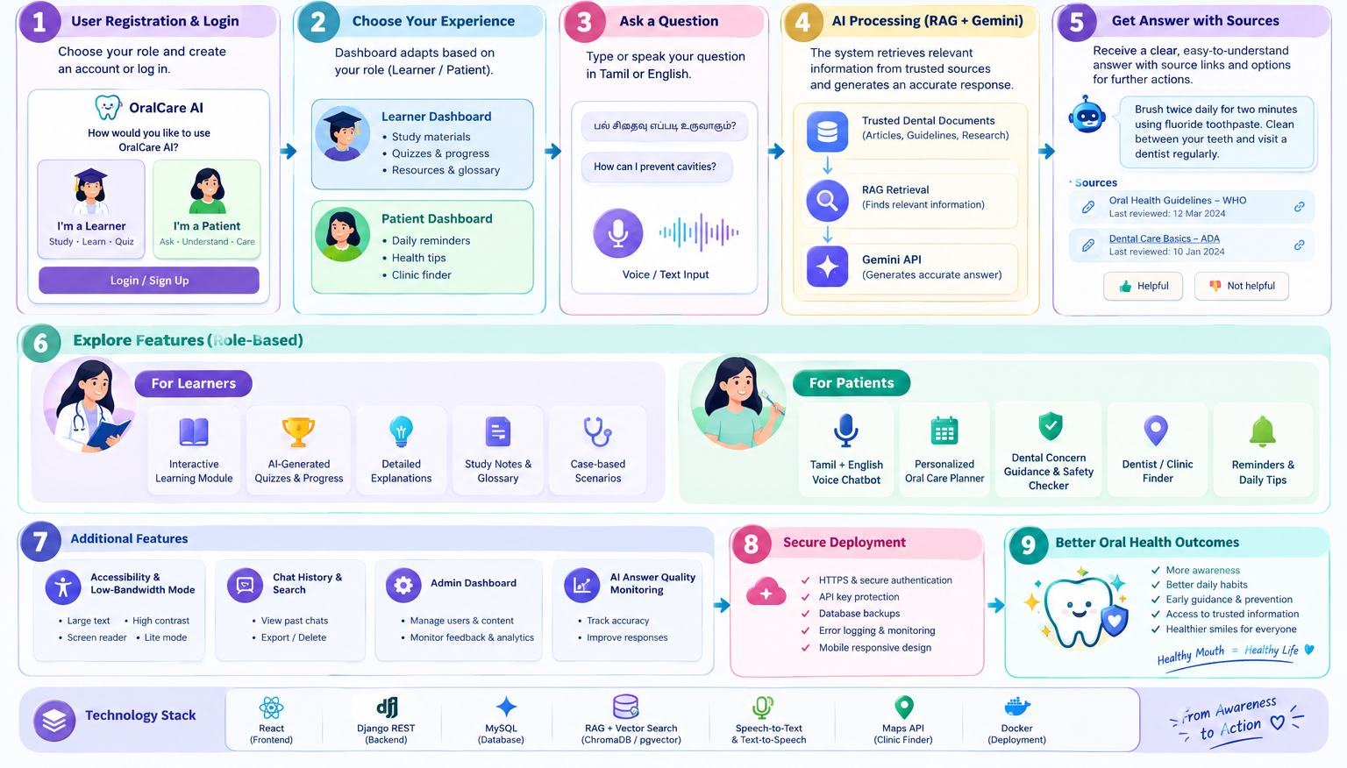
Overall System Workflow
06

Slide 8
Overall System Workflow
06
1
2
3
4
Sign up / Login
Role routing
Ask a question
Retrieve sources
Select Learner or Patient
Load the correct interface
Text or optional voice
RAG searches reviewed content
5
6
7
Generate answer
Show response
Feedback & logs
AI follows role + safety rules
Plain-language answer + references
Improve quality with privacy controls

Slide 9
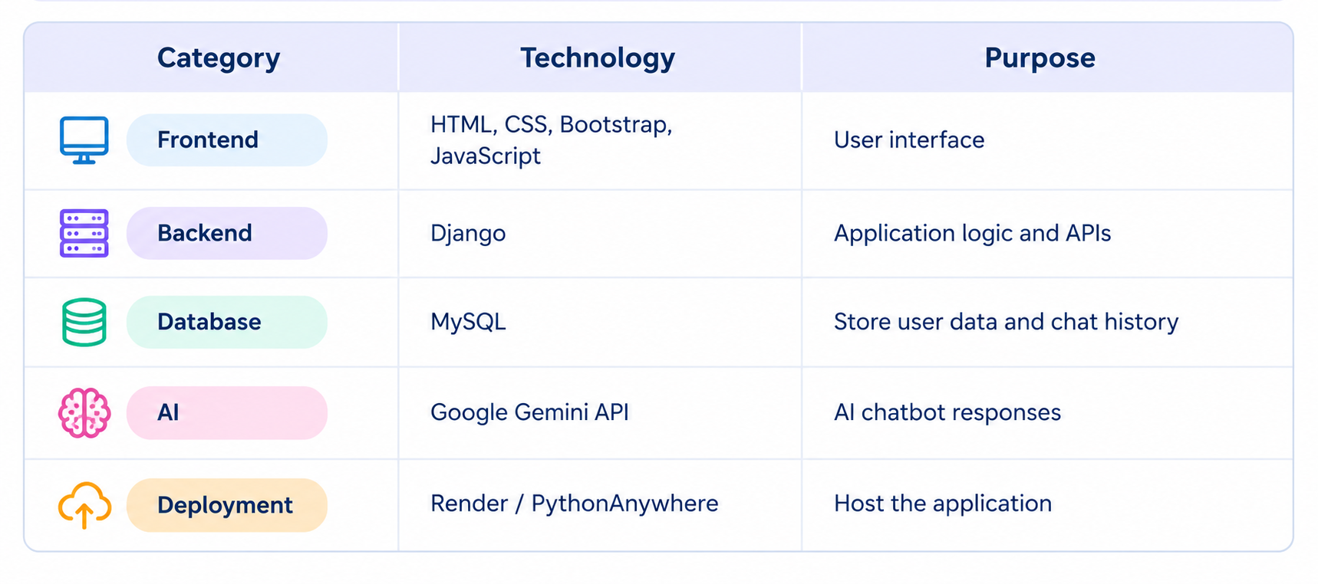
Proposed Technology Stack
07

Slide 10
Expected Outcomes
08
Better awareness
Role-relevant learning
Users can access understandable oral-care education anytime.
Learners receive structured explanations; patients receive simpler guidance.
More trusted answers
Improved accessibility
Source-grounded responses make information easier to verify.
Language and voice options can reduce barriers.
Proactive prevention
Measurable quality
Reminders and quizzes can encourage healthy routines.
Feedback, answer review, and evaluation help improve the system.
Success measures: answer usefulness, citation relevance, user satisfaction, task completion, and safe escalation.

Slide 11
Safety, Privacy & Deployment
09
Clinical safety
Privacy & security
Deployment readiness
• Educational support only
• No diagnosis or prescriptions
• Encourage dentist visits for persistent or severe symptoms
• Emergency warning messages when appropriate
• Secure password hashing
• Role-based backend permissions
• HTTPS and rate limiting
• Minimize sensitive data
• Clear chat-history controls
• Responsive UI
• Environment-based secrets
• Logging and monitoring
• Database backups
• Test RAG answers before release

Slide 12
Implementation Roadmap
10
1
PHASE 1
Foundation
Login, roles, chatbot UI, core API
2
PHASE 2
Trusted answers
Reviewed content, RAG retrieval, citations, safety rules
3
PHASE 3
User features
History, Tamil/English, voice, quizzes, reminders
4
PHASE 4
Admin & testing
Feedback dashboard, evaluation, privacy/security testing
5
PHASE 5
Deployment
Docker, cloud hosting, HTTPS, backups, monitoring

Slide 13
CONCLUSION
One platform. Two user journeys.
Safer, clearer oral health education.
The proposed system combines role-based design, AI, and trusted-source retrieval to make oral health learning and everyday guidance more accessible.
LEARN
GUIDE
VERIFY
Structured learning tools
Simple patient education
Sources + safety checks
Thank you

